Slide 1


Slide 2

TITOLO TITOLO
Testo testo
Testo Testo testo
Testo testo
Testo testo
Testo testo
Testo testo
Testo testo
Testo testo
Testo testo
Testo testo
Testo testo

Slide 3

TITOLO TITOLO
Testo testo
Testo Testo testo
Testo testo
Testo testo
Testo testo
Testo testo
Testo testo
Testo testo
Testo testo
Testo testo
Testo testo

Slide 4

THE FIRST EDITION OF THE EVENT WILL TAKE PLACE AT THE VICENZA EXPO CENTRE – ITALY FROM 27 TO 29 OCTOBER 2026, CONCURRENTLY WITH A&T – AUTOMATION & TESTING

Slide 5


SCENARIO AND MISSION
ADHESIVES BONDING & SEALANTS – ABS EUROPE 2026 is the premier international trade show and Italy’s first event dedicated exclusively to adhesives, bonding, sealants, foams, tapes, glues, resins, coatings, and films. It showcases the entire production and supply chain: raw materials, machinery, technologies, systems, plants, services and end products.
High-performance adhesives are increasingly replacing traditional fasteners like screws and bolts, driving innovation across sectors such as electronics, mechanics, packaging, graphics, printing, automotive, aerospace, furniture and household appliances. Similarly, coatings and paints play a crucial role across industries, offering technological advancements that businesses can’t afford to overlook.
With rising demand and continuous industry growth, the performance of adhesives, coatings and sealants is more critical than ever for product quality and manufacturing efficiency. Italy has a long-standing reputation for excellence in this field, making ADHESIVES BONDING & SEALANTS – ABS EUROPE 2026 a key event for manufacturers, distributors, and industry leaders.

Slide 6

NEW TRADE SHOW ON ADHESIVES BONDING & SEALANTS INDUSTRY
27-29 OCTOBER 2026 - VICENZA EXPO CENTRE
A new international event featuring hundreds of global companies showcasing the latest technologies, products, and solutions. It’s more than an exhibition - it’s the ultimate platform for innovation, networking and industry insights in Europe and beyond.
A clear and valuable project: the meeting between operators in the field and the world of production, distribution, technicians and end users. The event will be further enriched by a series of high-level conferences.
Operators will be able to confront themselves at all levels within an event built exclusively on their needs.
The protagonists will also be the sector associations and the primary political and economic institutions.

Slide 7

WHO VISITS
CONVERTERS
MANAGERS
TECHNICIANS
PLANNERS
PLANT DIRECTORS
DESIGNERS
ENGINEERS
CONSULTANTS
INSTALLERS
DEALERS
DISTRIBUTORS
WHOLESALERS
RETAILERS / DEPARTMENT STORES
SPARE PARTS AND SERVICE CENTERS
SUPPLIERS
TRADERS
CERTIFICATION BODIES
INVESTORS
R&D
EDUCATIONAL
INSTITUTIONS
MEDIA

Slide 8

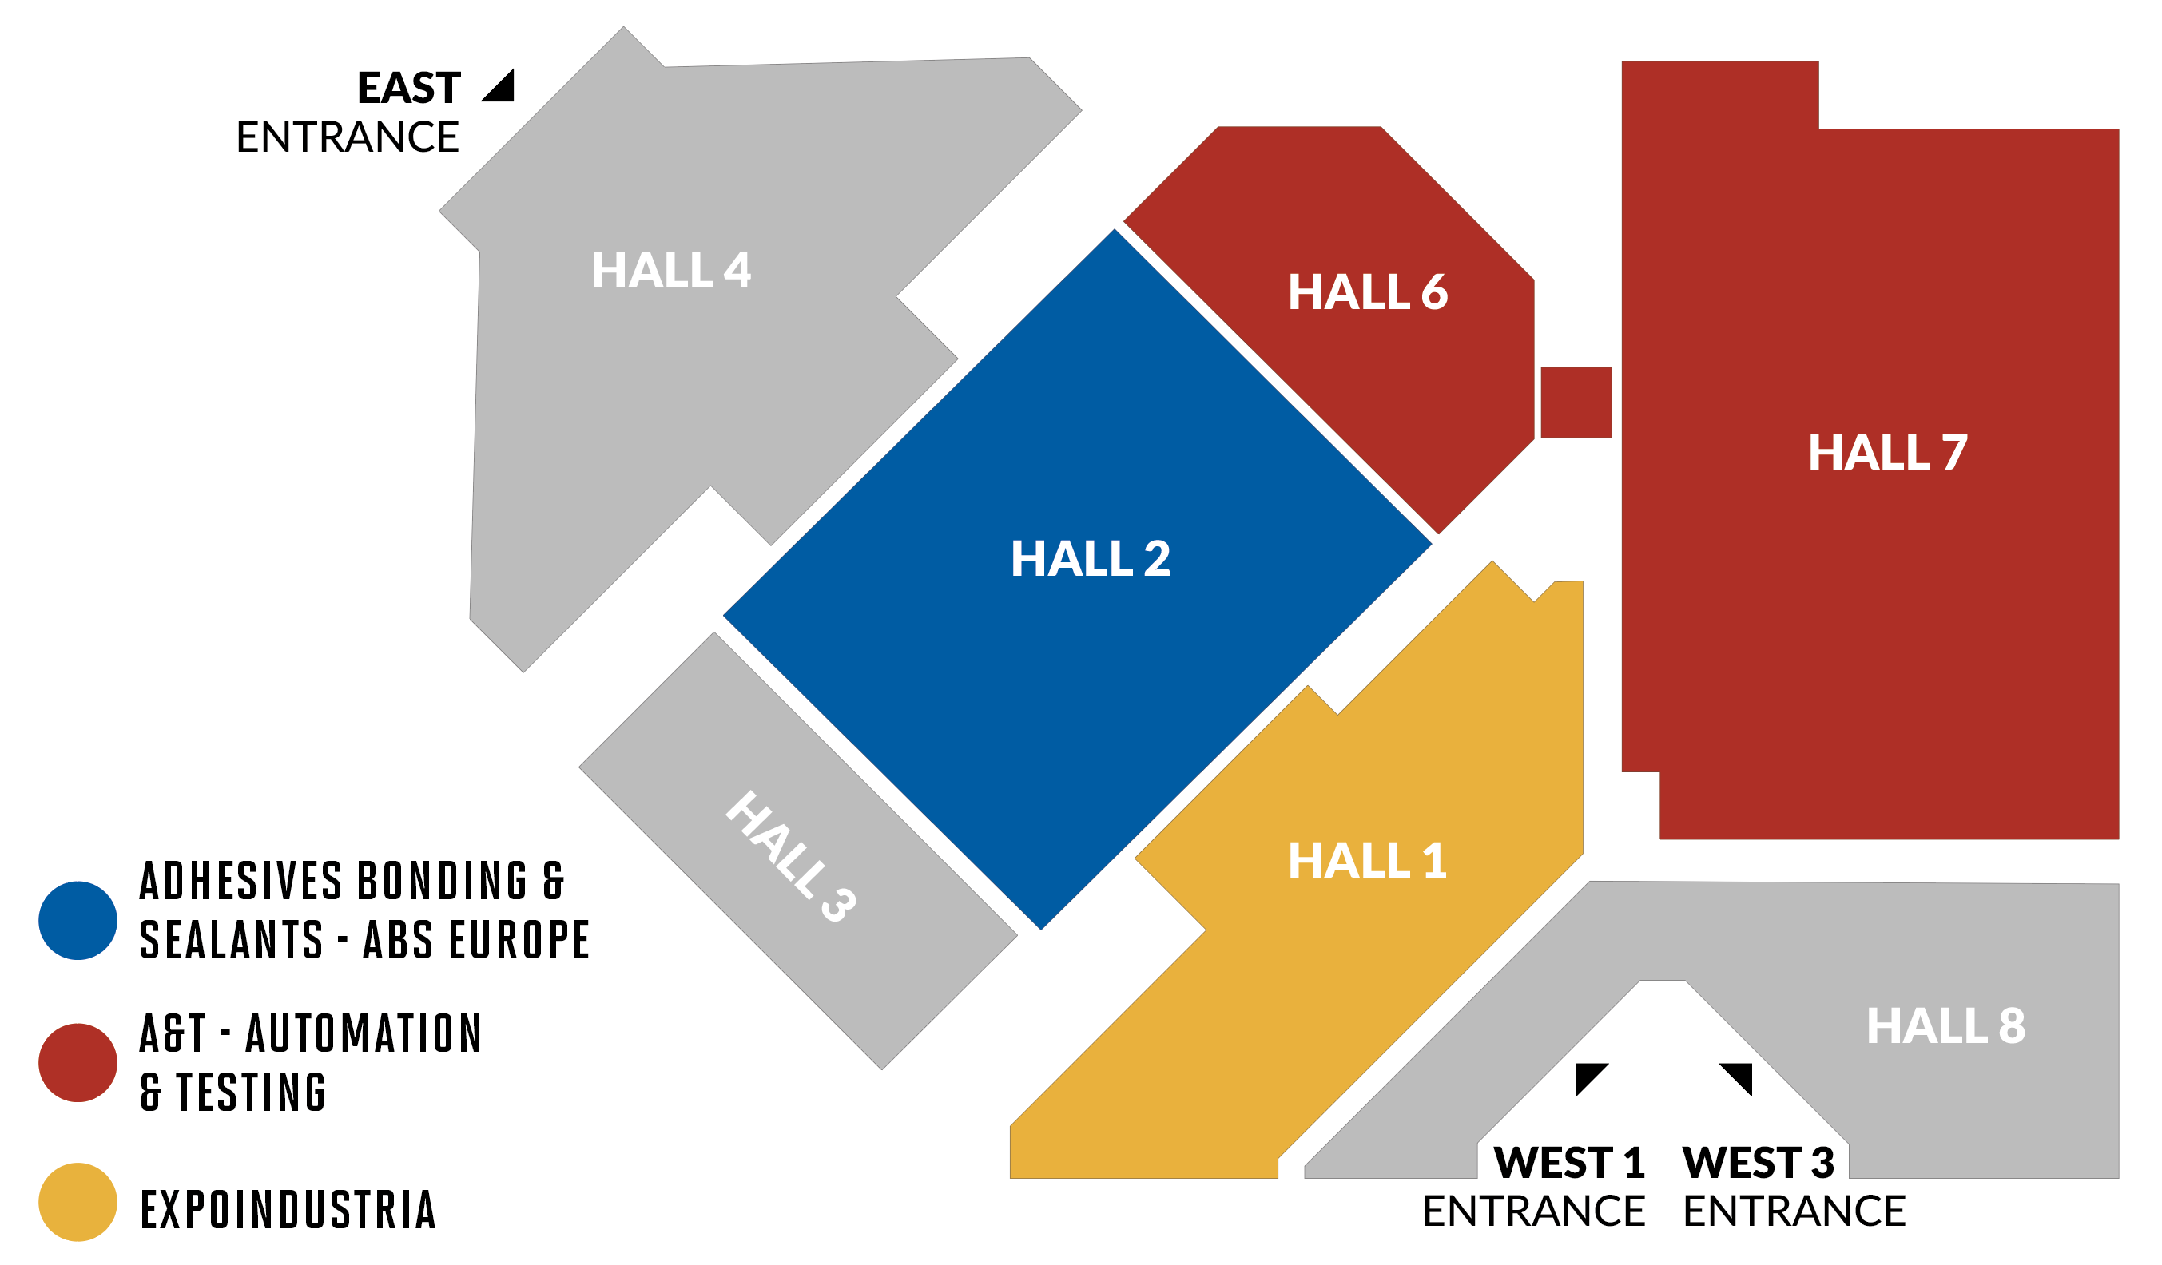

Slide 9

CONTEMPORANEITY WITH A&T
A&T – AUTOMATION & TESTING
A&T – AUTOMATION & TESTING - THE TRADE SHOW DEDICATED TO TECHNOLOGICAL SOLUTIONS, INNOVATION, RELIABILITY AND SKILLS 4.0 - 5.0
A&T is the leading exhibition dedicated to technological solutions, innovation, reliability and 4.0 – 5.0 skills: smart manufacturing, smart logistics, testing and metrology, process control, production control and additive manufacturing.
A&T Vicenza is in its fourth edition and evolved from a trade fair project with a 20-year history in Turin, representing a leading event for industrial and technological innovation.
With the same entrance pass, visitors will be allowed to visit the halls dedicated to ADHESIVES BONDING & SEALANTS - ABS EUROPE 2026 and those dedicated to A&T 2026, attend conferences and events organized by the two trade shows.

Slide 10


